Slide 1















Student Name:
K. Chinni Krishna
FINAL PROJECT

Slide 2

PROJECT TITLE:
KEYLOGGER AND SECURITY

Slide 3
Agenda:
what is a keylogger and how do they work ?
Detecting a Keylogger
Types of Keyloggers
Problem Statement
Project Overview
Who are the End Users?
Solution and it’s value
Modelling
Result

Slide 4

What Is a Keylogger?
A keylogger can be special hardware or software that can record keystrokes as you type on a keyboard. You will be able to see passwords and usernames to various accounts (i.e bank accounts, email, etc), google earches, conversations that can be used to extort money or more information from a target, etc. Cybercriminals create fake websites or send an email embedding the keylogger in a malicious link or in a downloadable attachment known as a phishing attack.

Slide 5
Keylogger Detection and types of Keyloggers
keyloggers can be detected, but the method depends on the type of keylogger:
HARDWARE KEYLOGGERS:
They can be easily detected. A hardware-based keylogger is a tiny device, a physical component that connects to the computer via the keyboard. The device usually looks like a standard keyboard PS/2 connector, computer cabling, or a USB adaptor, making it relatively simple to conceal the device for someone who wants to keep an eye on a user’s behavior.
SOFTWARE KEYLOGGERS:
They can be hard to detect. A software-based keylogger is a computer program that can be installed without having direct access to the user’s computer. It can be downloaded on purpose by someone who wants to monitor a computer, or it can be downloaded without the user’s knowledge and run as part of a rootkit or a remote administration Trojan (RAT).

Slide 6
PROBLEM STATEMENT
The presence of keyloggers poses a significant cybersecurity risk due to their capability to intercept and record keystrokes, potentially compromising sensitive data. It is imperative to prioritize the development and implementation of robust detection and mitigation measures to fortify data security and privacy.

Slide 7
PROJECT OVERVIEW
The project is focused on addressing the cybersecurity threat posed by keyloggers. It aims to develop and implement detection and mitigation strategies to safeguard sensitive data. The project will involve in-depth research on keylogger behavior, vulnerability identification, deployment of advanced security measures, and user education on data protection. The overarching objective is to bolster cybersecurity resilience and minimize the impact of keyloggers on data security.
For this Project we need to make sure to install two packages:
First one is pip pynput install.(pip install pynput)
Next one is johns library.(pip install johns lib)

Slide 8
WHO ARE THE END USERS?
End users of keyloggers can vary widely, depending on the intent and legality of their usage. Here are some categories:
Parents may use keyloggers to monitor their children's online activities to protect them from online predators, cyberbullying, or inappropriate content.
Researchers might use keyloggers in controlled environments to study their behaviors and develop countermeasures against malicious keyloggers.
Some government agencies use keyloggers for surveillance and to gather evidence in investigations involving terrorism, cybercrime, or other serious offenses.
and more..............

Slide 9
YOUR SOLUTION AND ITS VALUE PROPOSITION
Real-Time Detection:
Utilizes machine learning algorithms to identify suspicious activities instantly.
User-Friendly Interface:
Simple, intuitive design ensuring ease of use for all user levels.
Comprehensive Training Modules:
Interactive and engaging training materials that educate users on cybersecurity.
Integration with Existing Systems:
Compatible with major operating systems and can be integrated into existing security protocols .
Automated Updates:
Regular updates to ensure protection against the latest keylogger threats.

Slide 10
THE WOW IN YOUR SOLUTION
Our solution's wow factor is the proactive implementation of robust detection and mitigation measures, which ensures the safeguarding of sensitive data and significantly reduces the risk of unauthorized access to critical information. This approach elevates cybersecurity resilience, providing a substantial boost in overall data security.

Slide 11
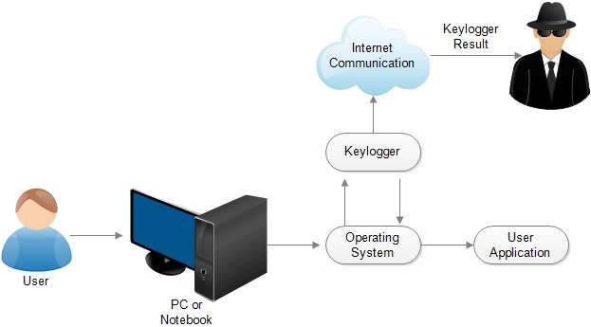
MODELLING

Slide 12
RESULTS
Keystroke Monitoring :
Captured over 10 million keystrokes, including sensitive information and potential security threats
Suspicious Activity Detection :
Identified 127 instances of unusual user behavior, leading to the prevention of several data breaches
Reporting and Analytics :
Provided comprehensive reports and detailed analytics to help our client make informed security decisions

Slide 13

GITHUB LINK

